Slide 1


Countdown to
ACSDA T+1 Webinar
January 20, 2022
Keith Evans – Executive Director, CCMA

Slide 2
A brief history of the CCMA
Launched 1999; communicates, educates, helps co-ordinate Canadian capital market projects
Initial projects were:
  T+1 → STP
  NI 24-101 → trade-matching requirements
‘Moth-balled’ 2008; revitalized 2015
T+2 completed 2017
Today’s priorities:
  TMX/CDS – Post-Trade Modernization (PTM)
  T+1 – shorter securities settlement cycle

Slide 3
T+1 – why now?
U.S. announced transitioning to T+1
Canada must transition at the same time
Canadian Securities Commissions
  Endorsed shortening settlement cycle to T+2
  Expected to do the same for T+1
Firms asking themselves why change, must either
  make the changes to move to T+1, or
  make changes to accommodate counterparties on T+1

Slide 4
T+1 benefits
Mitigation of counterparty risk
Reduction in margin and liquidity demands, especially during periods of market volatility
More efficient, safer, better service for investors
But… not everyone will benefit equally

Slide 5
Who will be involved?
Buy side (asset managers)
Sell side (dealers)
Custodians
Infrastructure: CDS, Fundserv, exchanges
Service providers, vendors
Regulators
Note: Degree of involvement will differ

Slide 6
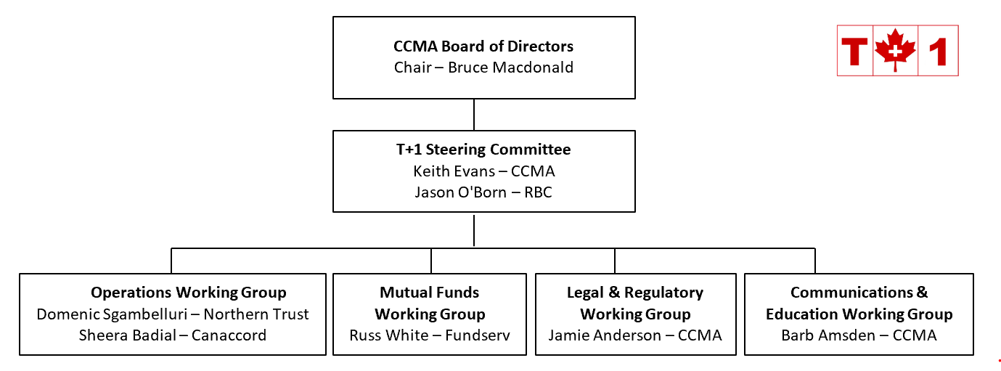
How are our T+1 efforts organized?

Slide 7
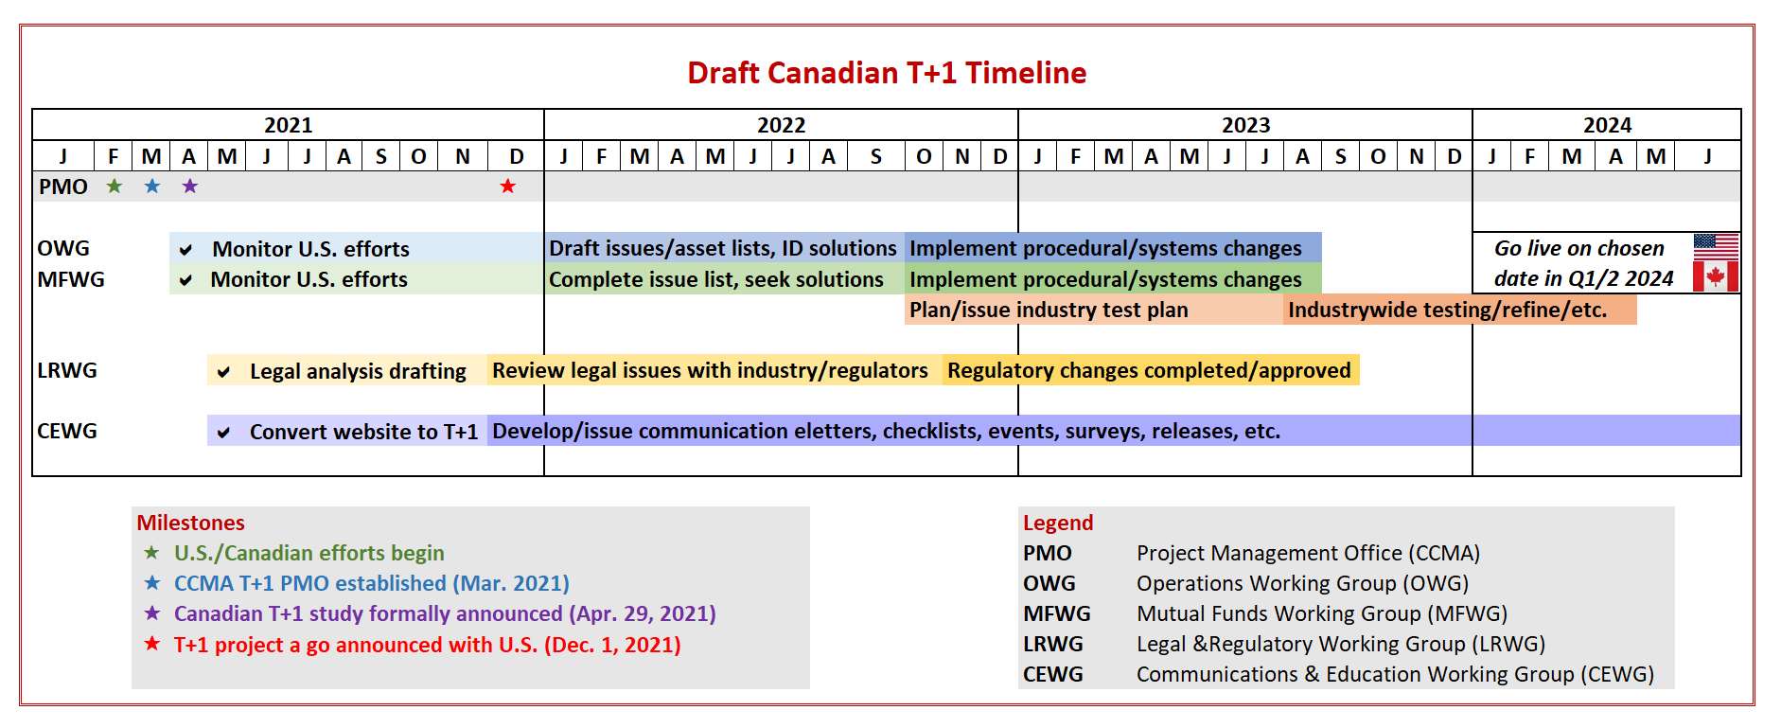
Schedule – pending review

Slide 8
In scope for review
Trade entry
Trade reconciliation
Block trade allocation (potential changes to NI 24-101)
Trade matching
Inter-listed securities
Corporate actions and entitlements
Securities lending
Foreign exchange
ETF/mutual fund processing
Regulatory changes
Client communication

Slide 9
What are the major risks for T+1?
Canada is being driven by the U.S. timelines
  Any change in the U.S. timeline directly impacts the Canadian timeline… but NOT vice versa
Elimination of equities and debt overnight batch processes
  Most activity being done on T+1 will now likely need to be done on T
  Will add costs to the industry
CDS PTM project timelines

Slide 10
What can firms be doing now?
Check out www.ccma-acmc.ca
Sign up for newsletter by emailing info@ccma-acmc.ca
Review T+2 Post Mortem Report
See Frequently Asked Questions as updated

Slide 11

Questions?

