Slide 1
Rethinking Corporate Governance: Challenges for board governance FMIs in the ChatGPT era
September 07, 2023

Slide 2
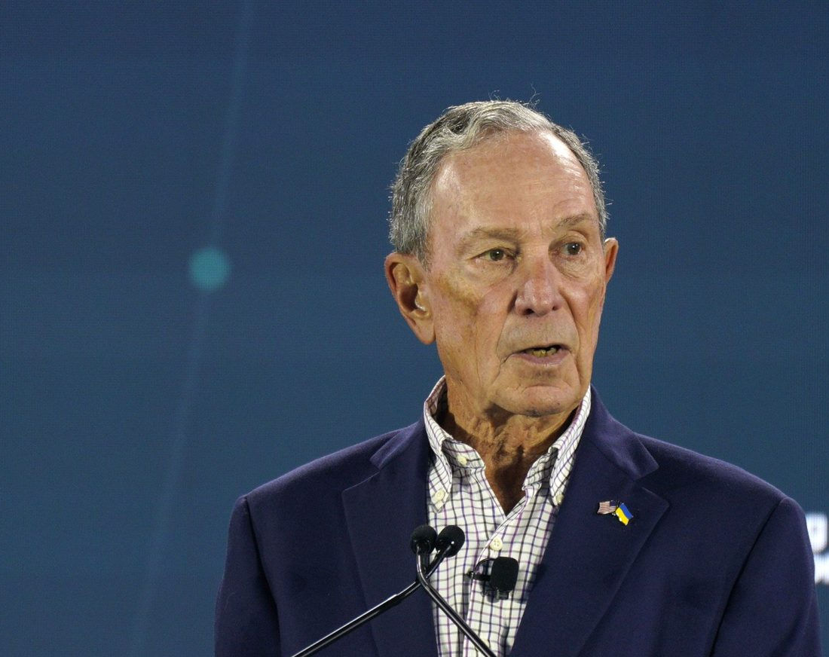
Last week Michael Bloomberg made a radical decision to ax his entire board of directors.
“One of the hallmarks of Bloomberg is our ability to make changes from a position of strength – not out of fear when times are tough.”
“We’re successful because we change and adapt – always thinking about tomorrow, not what we did yesterday, and always doing things first.”
“We don’t necessarily have all the good ideas, but with the adoption of new non-conventional solutions we can stay at the forefront of our industry. It’s critical that we never lose that mindset, particularly given the rate of change in the world, which none of us have seen before.”

Slide 3
The failure of SVB’s Corporate Governance system
The corporate decision-making system must be able to read signals timely to make quality decisions.
We need decisions to overcome this new scenario of business fragility, incomprehensible factors and exponential changes.
The role of the board can no longer be passive in the face of mechanical and operational risk reports; its responsibility is to govern the risks.

Slide 4
Key Determinants of FMIs' Corporate Governance
Currently corporate governance faces a dynamic landscape in which several determining factors come into play:
01 Exponential Responsibilities
Increased demands on boards due to the complex nature of modern business; constant new regulation, growing expectations on technological change, sustainability dynamics; and increasing demands for risks oversight.
02 Time Constraints
Managing the pace of decision-making in a fast-moving business environment.
03 Collective decision processes
Overcoming the challenges associated with diversity of mindsets, perspectives and interests.

Slide 5
Key Determinants of FMIs' Corporate Governance
By their nature FMIs are characterized by additional specific factors that influence their corporate governance:
01 Complex tasks for governance systems including risks and market regulation
A CG system that must be concerned with both the creation of shareholder value and the stability and trust in the market.
02 Conflicts of interests
Inherent conflicts of interest of directors who are at the same time market participants, shareholders and potential competitors.
03 Group Structure (holdings – subsidiaries relationship)
Clear attributions and responsibilities for holding v. subsidiary boards and committees.

Slide 6
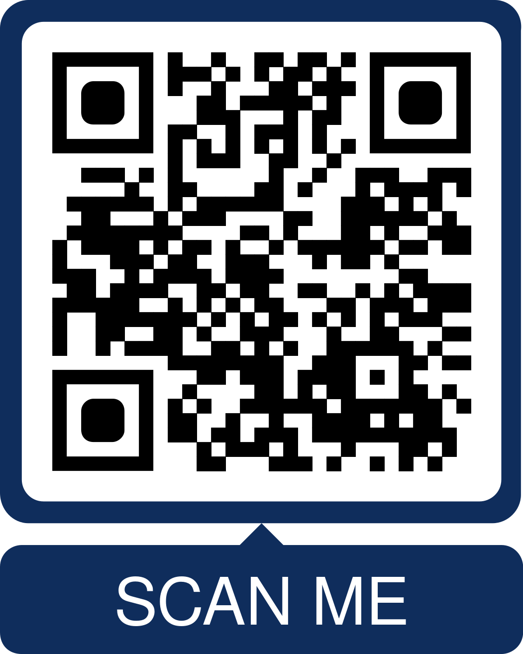
From your perspective, what are the key challenges or priorities to be addressed by FMIs' Boards?
Notes:
https://admin.sli.do/event/aALXHZPZUGcZtxS7amoBrH/polls

Slide 7
“Give me six hours to chop down a tree and I will spend the first four sharpening the axe.”
- Abraham Lincoln

Slide 8
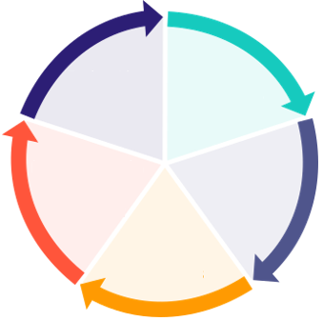
Our view of the solution: Evaluation as a trigger for innovation and continuous improvement
Board as an effective working group
Individual (self/peer)
Evaluation serves to enhance accountability and effectiveness for several Corporate Governance dimensions.
- Board of Directors evaluation (as a body)
- Self and peer evaluation (individual perspective)
- Committees and its interaction with Board
- CEO and C-level performance evaluation
- Profiles gap analysis (what knowledge we have vs. what we should have at the board)
Profiles gap analysis
Committees
CEO and Senior Management
Notes:
Alignment of understanding (directors, managers and external participants perspectives)
Commitment (individual directors)
Processes (back-office of the management as well as board dynamics)
Instruments for board effectiveness (agenda, work plan, reporting outline and key indicators, minutes)
Corporate documents (charters and policies - eg. Conflict of interest's management policy)

Slide 9
What can be done?
Ask your board of directors about these questions
Is the Board making quality decisions at the pace the market is requiring?
Is this board really understanding and tackling on new expectations from our stakeholders (market participants, investors, regulators, etc…)?
Is this Board really contributing to visualize the future of our FMI?
Are we having a sufficient view / understanding of strategic and emergent risks?
Are we properly managing inherent conflicts of interests (derived of participants/competitors acting as directors)?

Slide 10
+57 333 602 5086
Cra. 11 # 86 - 60, of. 302
Bogotá, Colombia.
+1 305 2225005
Red Road 3600 (602)
Miramar – FL, United States.
www.governanceconsultants.com

