Slide 1
Innovation through Fintechs in the CSD world

Slide 2
Edwin De Pauw
Euroclear Head of Data Services & Innovation
Hugues Flament
Data Services & Innovation
Sébastien Van Campenhoudt
Government Relations & Public Affairs

Slide 3
Agenda
Why looking at Fintechs ?
What are the big questions to answer before scouting ?
Overview of regulations in Europe and how that impacts relations with Fintechs
How to screen and select the right Fintech ?
Overview of Euroclear Fintech portfolio
Q&A

Slide 4
Why looking at fintechs Expected benefits scouting/ investment
Market research | Growth | Partnerships | Financial return | New capabilities
Obtain a better and more detailed understanding of industry and new technology trends | Develop new products and services contributing to the company growth | Build partnerships with other industry players around market solutions and/ or enter into new ecosystem | Achieve positive return on investment | Acquire new technology skills and capabilities

Slide 5
Questions to answer before scouting Which process to follow?
Fintech strategy
Fintech scouting
Fintech collaboration
Innovation strategy
Fintech investment themes
Pipeline building
Fintech selection
Value capture
Performance monitoring

Slide 6
Questions to answer before scouting How do we link to Corporate Strategy?
Opportunities
Corporate strategy
Products and Services
Extrapolation
Financial instrument types
_________________
Securities services
_________________
Securities markets
Products and solutions
_________________
Technologies
_________________
Customer requirements
Pillar 1
Pillar 2
Pillar 3
Operational excellence

Slide 7
Questions to answer before scouting How do we link to external trends?
Opportunities
Retropolation
Scenario planning
Trends
High Impact
Financial industry trends
_________________
Regulatory focus
_________________
Technology trends
_________________
Competition watch
_________________
Fintech landscape
Potential of new market
_________________
Technologies and business effects
_________________
Customer requirements
Major Disruption
Strategic Shift
Low probability
High probability
Flash in the Plan
Incremental Change
Low Impact

Slide 8
Questions to answer before scouting How to derive investment themes?
Opportunities
Enter new markets/industries
Expand into new customer base
Create first mover advantage
Consolidate and grow quickly in size
Employ new technology
Access greater pool of skills and experience
Non-organic growth?
Fintech investment themes

Slide 9
Regulatory overview Main EU legislation for trading and post-trading
Markets in Financial Instruments Directive (MiFID II & MiFIR)
Trading
European Market Infrastructure Regulation (EMIR)
Clearing
Settlement custody
CSD Regulation (CSDR)

Slide 10
Regulatory overview
Making the EU fit for the digital decade
EU Digital Strategy - 3 Packages
CMU 2.0
Cyber Security package
NIS 2 Directive
Directive on critical infrastructures
E-commerce directive
Digital Services package
Digital Services Act (DSA)
Digital Markets Act (DMA)
Digital Finance package
Digital Operational Resilience Act (DORA)
Markets in Crypto-assets (MiCA)
DLT Pilot Regime
Make the existing financial legislation « fit for digital »
Targeted
companies
All companies using digital services
(e.g. banks, rail, planes,…)
Digital intermediaries and platforms
(e.g. Google, Airbnb, Uber,…)
All Financial market players
(e.g. banks, CSDs, CCPs, asset managers,…)
Individual objectives
Ensure safety through technical upgrades and re-design of IT architecture
Create a safer and more competitive digital space
Allow for innovation while ensuring the stability and safety of the financial markets
Overall objective
Ensuring resilient innovation

Slide 11
Regulatory overview Digital finance package
The Digital Finance Package, released in Sept. 2020, contains three proposals:
A Digital Operational Resilience Act for the Financial Sector (DORA),which aims at consolidating & harmonising EU-rules on digital operational resilience of financial entities.
A Regulation on Markets in Crypto-assets (MiCA) which aims at regulating crypto-assets not falling in scope of the existing regulatory framework (e.g. stablecoins such as DIEM);
A Regulation setting-up a pan-European ‘DLT Pilot Regime’ which would allow entities to ask for exemptions from certain regulatory requirements to stimulate the development of DLT and test the existing regulatory framework against this new technology.
Content
Status
These initiatives are now being discussed at Council and EP level.
Texts will therefore further evolve.
Plan
Expectation is to have stable versions in H2 2021: implementation dates are likely to be subject to political decision.

Slide 12
How to screen / select fintechs Problem statement
There are > 2,000 fintechs in the Capital Markets industry
With growing funding
Spread in all parts of the value chain
Primary market, Pre-Trade, Trade execution, Post-Trade

Slide 13
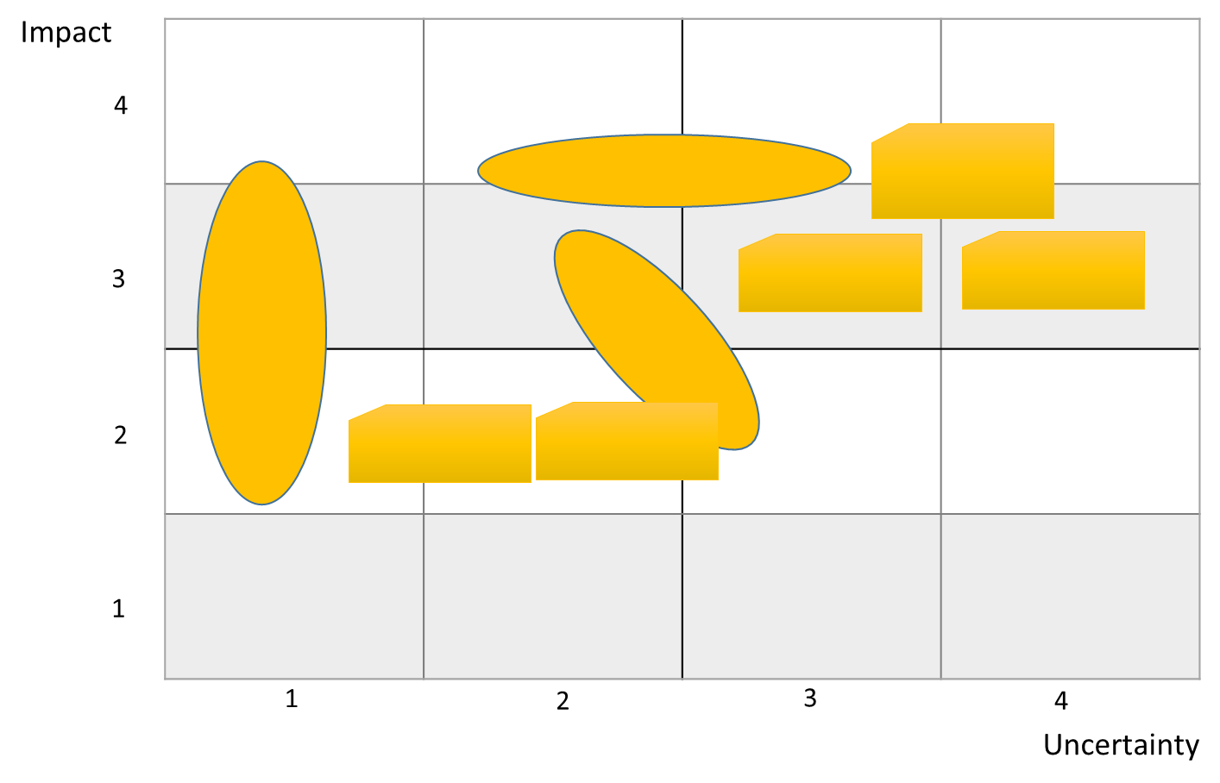
How to screen / select fintechs Pipeline building – step 1
Fintech investment themes

Slide 14
How to screen / select fintechs Pipeline building – step 2
Themes
Internal organisation
Active scouting
Fintech incubators / BA network / Open call for fintechs
Fintech selection

Slide 15
How to screen / select fintechs Fintech selection
Inflow
High-level analysis
1
2
3
In-depth analysis
Innovation theme alignment
Multi-criteria analysis
Firm | Euroclear fit | Funding
Current product offerings Future product offerings Clarity of thoughts Etc. | Strategic fit Contribution Reputational impact Innovation effect Etc. | Current valuation Current key figures Current funding Current investors Etc.

Slide 16
How to screen / select fintechs Fintech collaboration
Various options to consider
Partnership e.g. commercial relationship / PoC
Financial investment (equity) minority or majority
Loan/convertible debt
Acquisition
Even without being a shareholder, possible to monitor performance of fintechs being part of Strategic Committees / Advisory Boards
Need to capture value and monitor performance

Slide 17
Euroclear fintech investment portfolio

