Slide 1
*
*Working Title - may still change

Slide 2
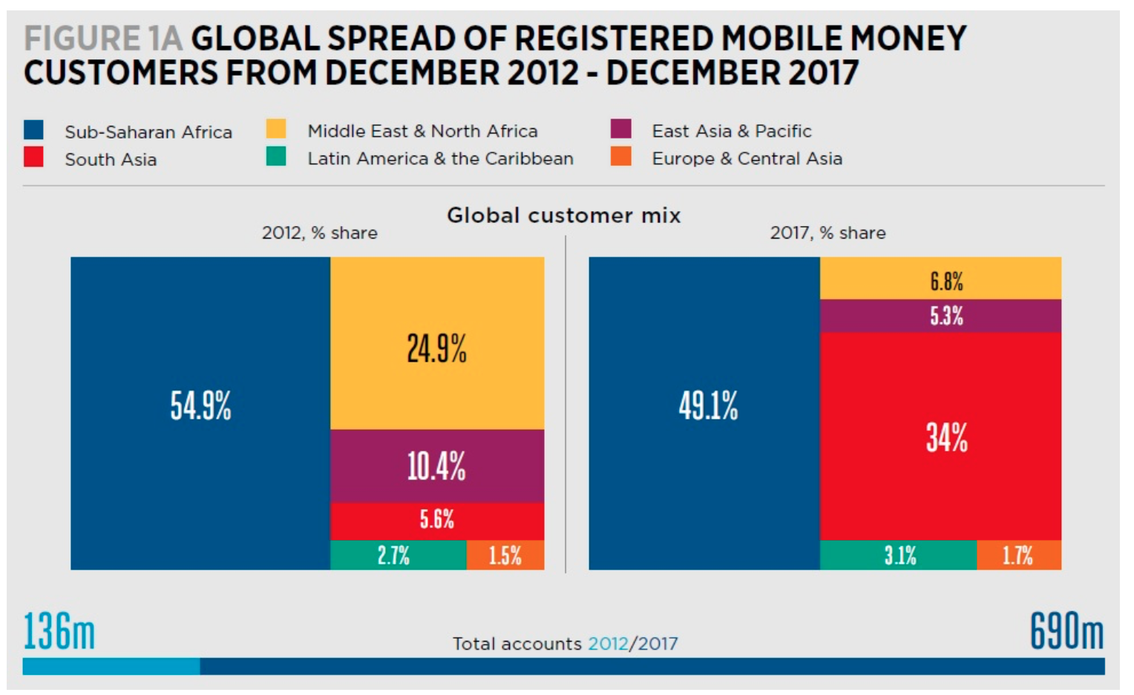
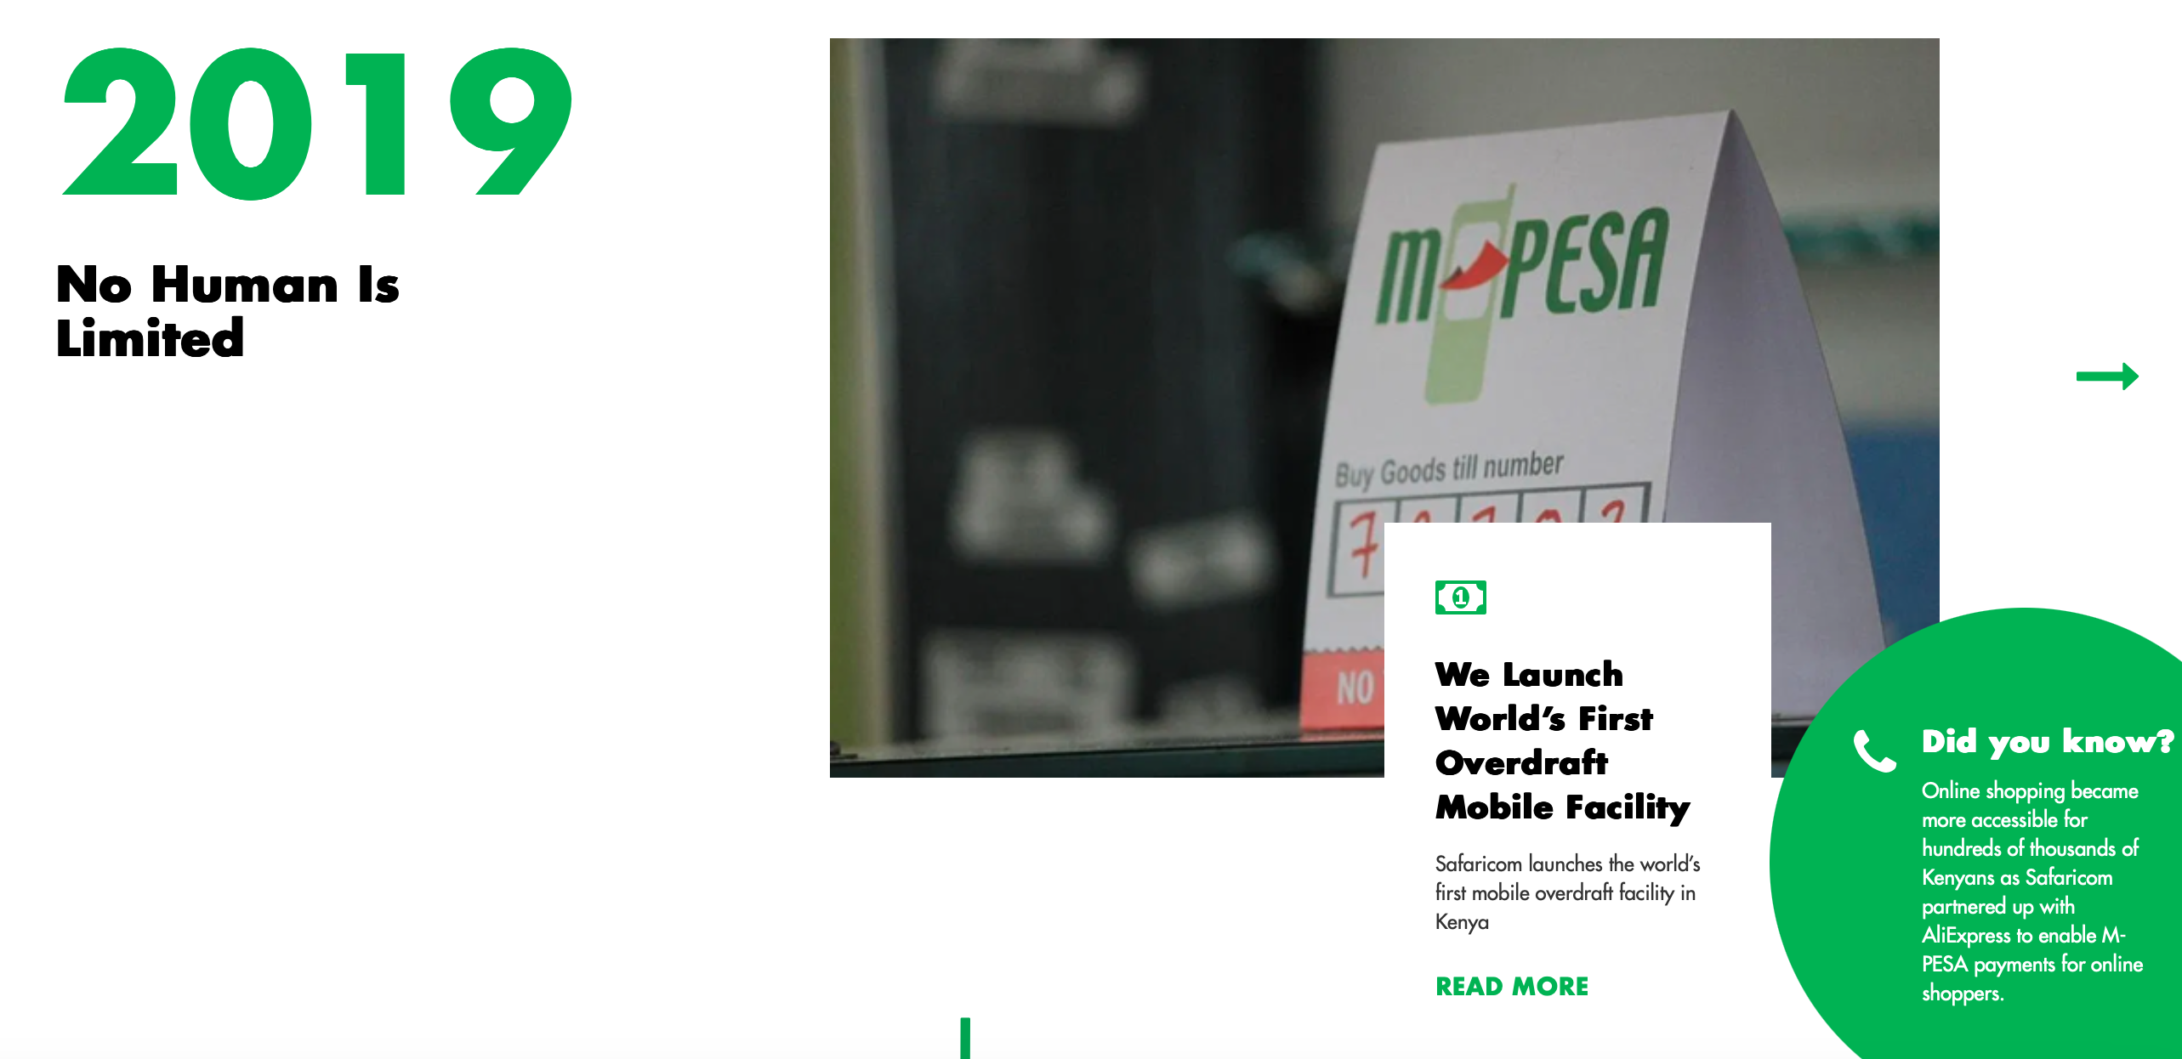
Change happens ….. literally overnight!
Today some 46.7m people in Kenya (out of a total of 56,2m) use the platform

Slide 3
A bit of the backdrop …..
Declining trade volumes in many of our markets
A decline in formal listings
“Sovereign ratings” downgrades (or the struggle with weaker ratings)
“Grey Listing”
Increases in
Operational costs
the investment into “resilience”
costs being incurred in “stronger” currencies
Regulatory costs
Focus on Cyber resilience and data protection
Regulation itself

Slide 4
How do we get the balance right?
At the country level, we demonstrate that FinTech activity is attracted to more competitive, profitable, and developed financial systems. At the same time, incumbents in countries with stronger regulatory standards reap the advantages of increased FinTech penetration. This indicates that well-designed regulations can foster a level playing field, enabling new FinTech firms to thrive while simultaneously protecting incumbent FIs from potentially uneven competitive practices.
IMF Working Paper WP/23/239
Striking the right balance between promoting financial innovation and mitigating systemic risk is critical

Slide 5
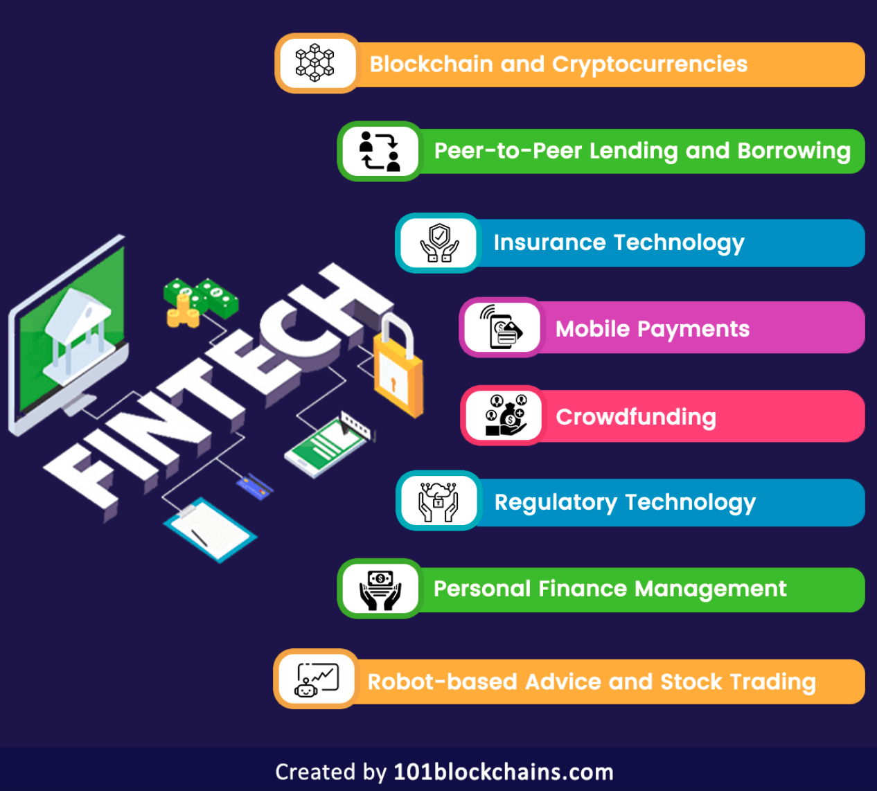
A few terms …..
The financial technology, or FinTech industry, is a rapidly evolving field that seeks to improve and modernize traditional financial services through innovative technologies and processes.
Terms are often used interchangeably …. but do so at your peril!

Slide 6
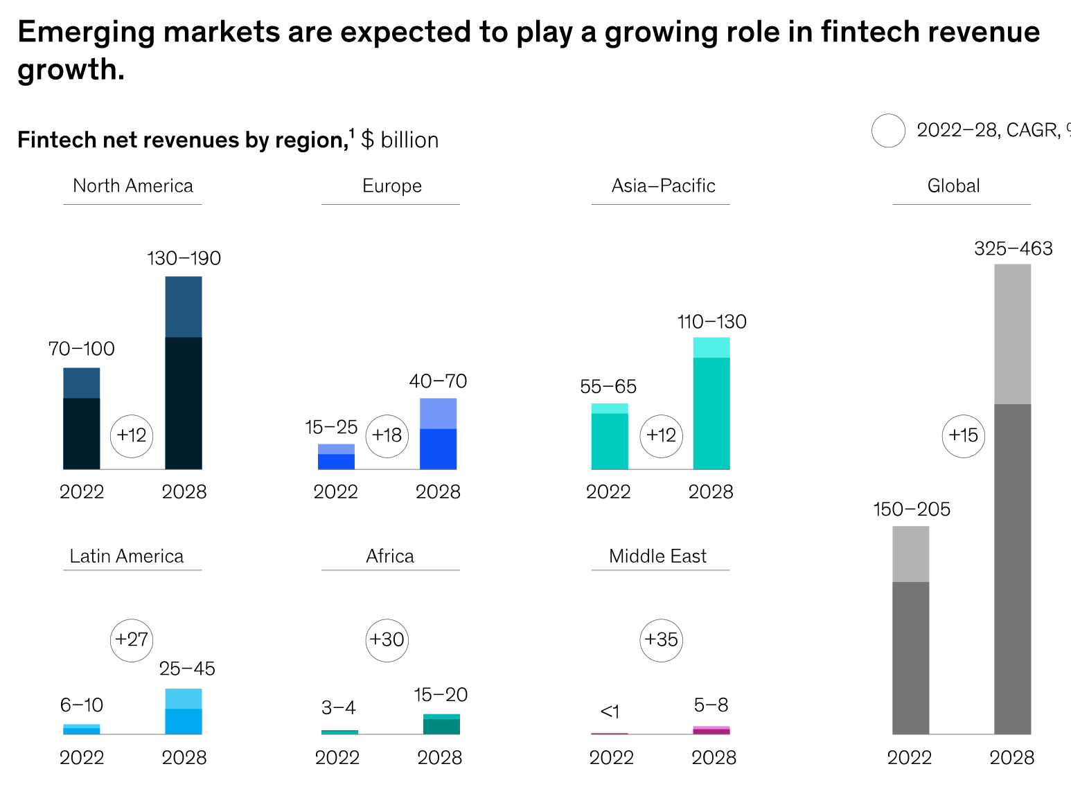
Fintechs – A new paradigm of growth
(McKinsey and Company - October 2023)
McKinsey’s research shows that revenues in the fintech industry are expected to grow almost 3 times faster than those in the traditional banking sector between 2023 and 2028

Slide 7
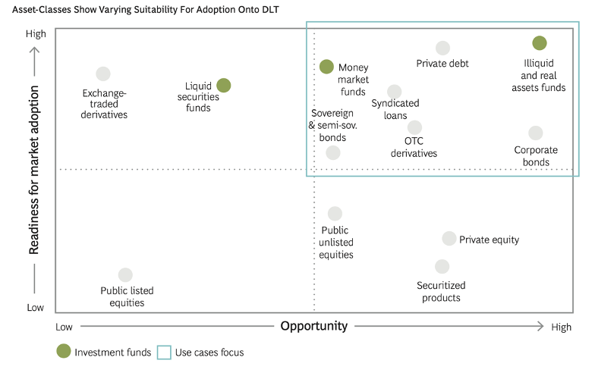
Opportunities… a focus on DLT
Source: “The Impact of Distributed Ledger Technology in Global Capital Markets”: www.gfma.org

Slide 8
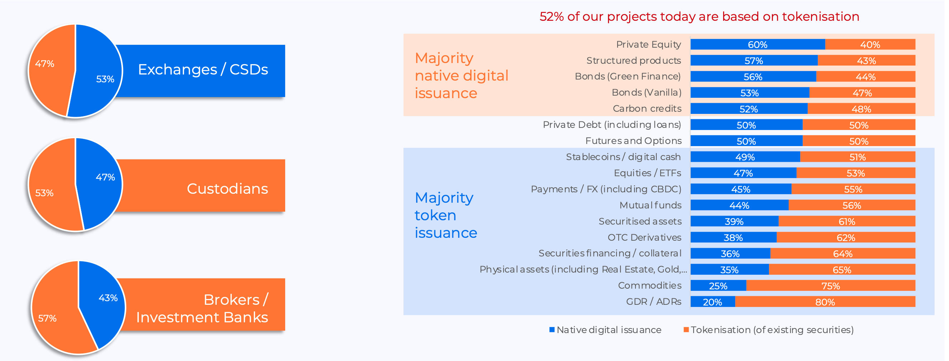
Tokenisation…
Source: “DLT in the real world” Survey, 2023: www.issanet.org

Slide 9
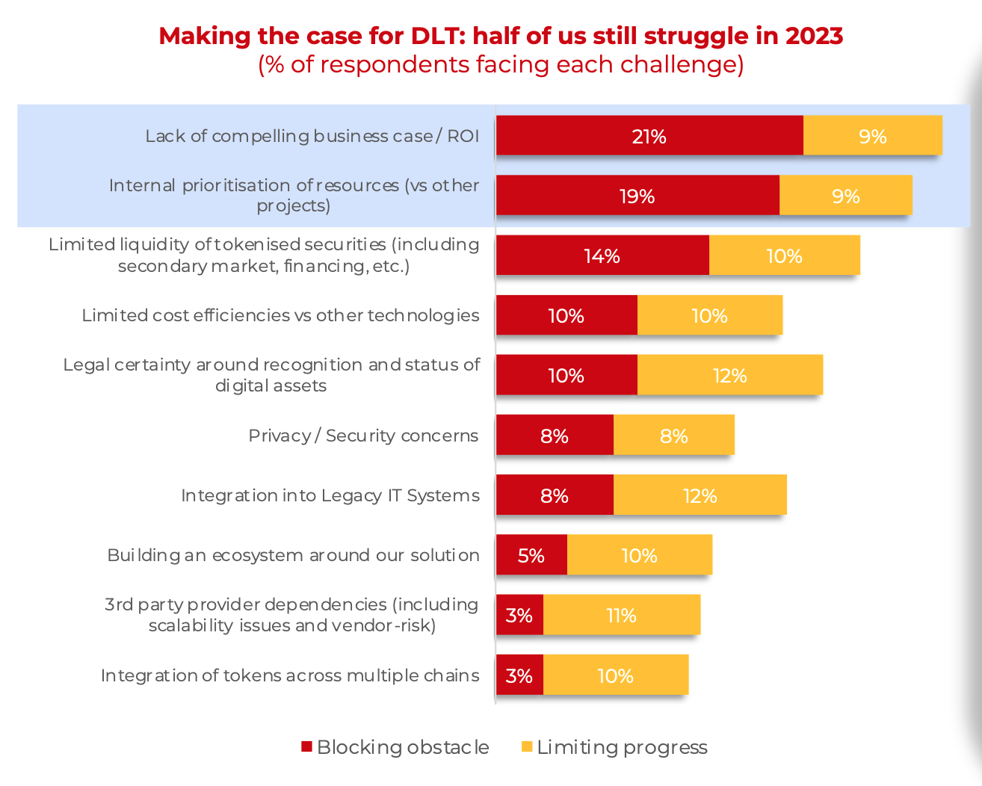
Some of the challenges …
Source: “DLT in the real world” Survey, 2023: www.issanet.org

Slide 10
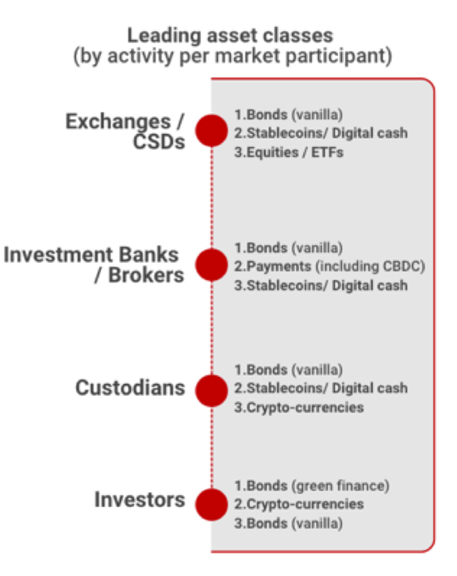
“Common”
or
“Conflicting” priorities
Source: “DLT in the real world” Survey, 2023: www.issanet.org

