Slide 1
Clearstream Market Partnerships

Slide 2
Significant Trends Shaping the Future Post-trade Industry
Increasing pace of technological disruption | Cost pressure requiring scale and technological capability
DeFi business models receive regulatory attention | Industry partnerships to create E2E efficiencies

Slide 3
Clearstream Collateral Management Service for Market Infrastructures
Risk Mitigation
Regulatory & Compliance
Liquidity Management
Global Reach
Technological Innovation
Client Support and Strategic Partnership
Clearstream has > 11 years of extensive experience in supporting market infrastructures in setting-up an end-to-end domestic Collateral Management Service in response to a growing market demand.

Slide 4
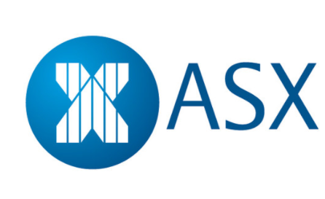
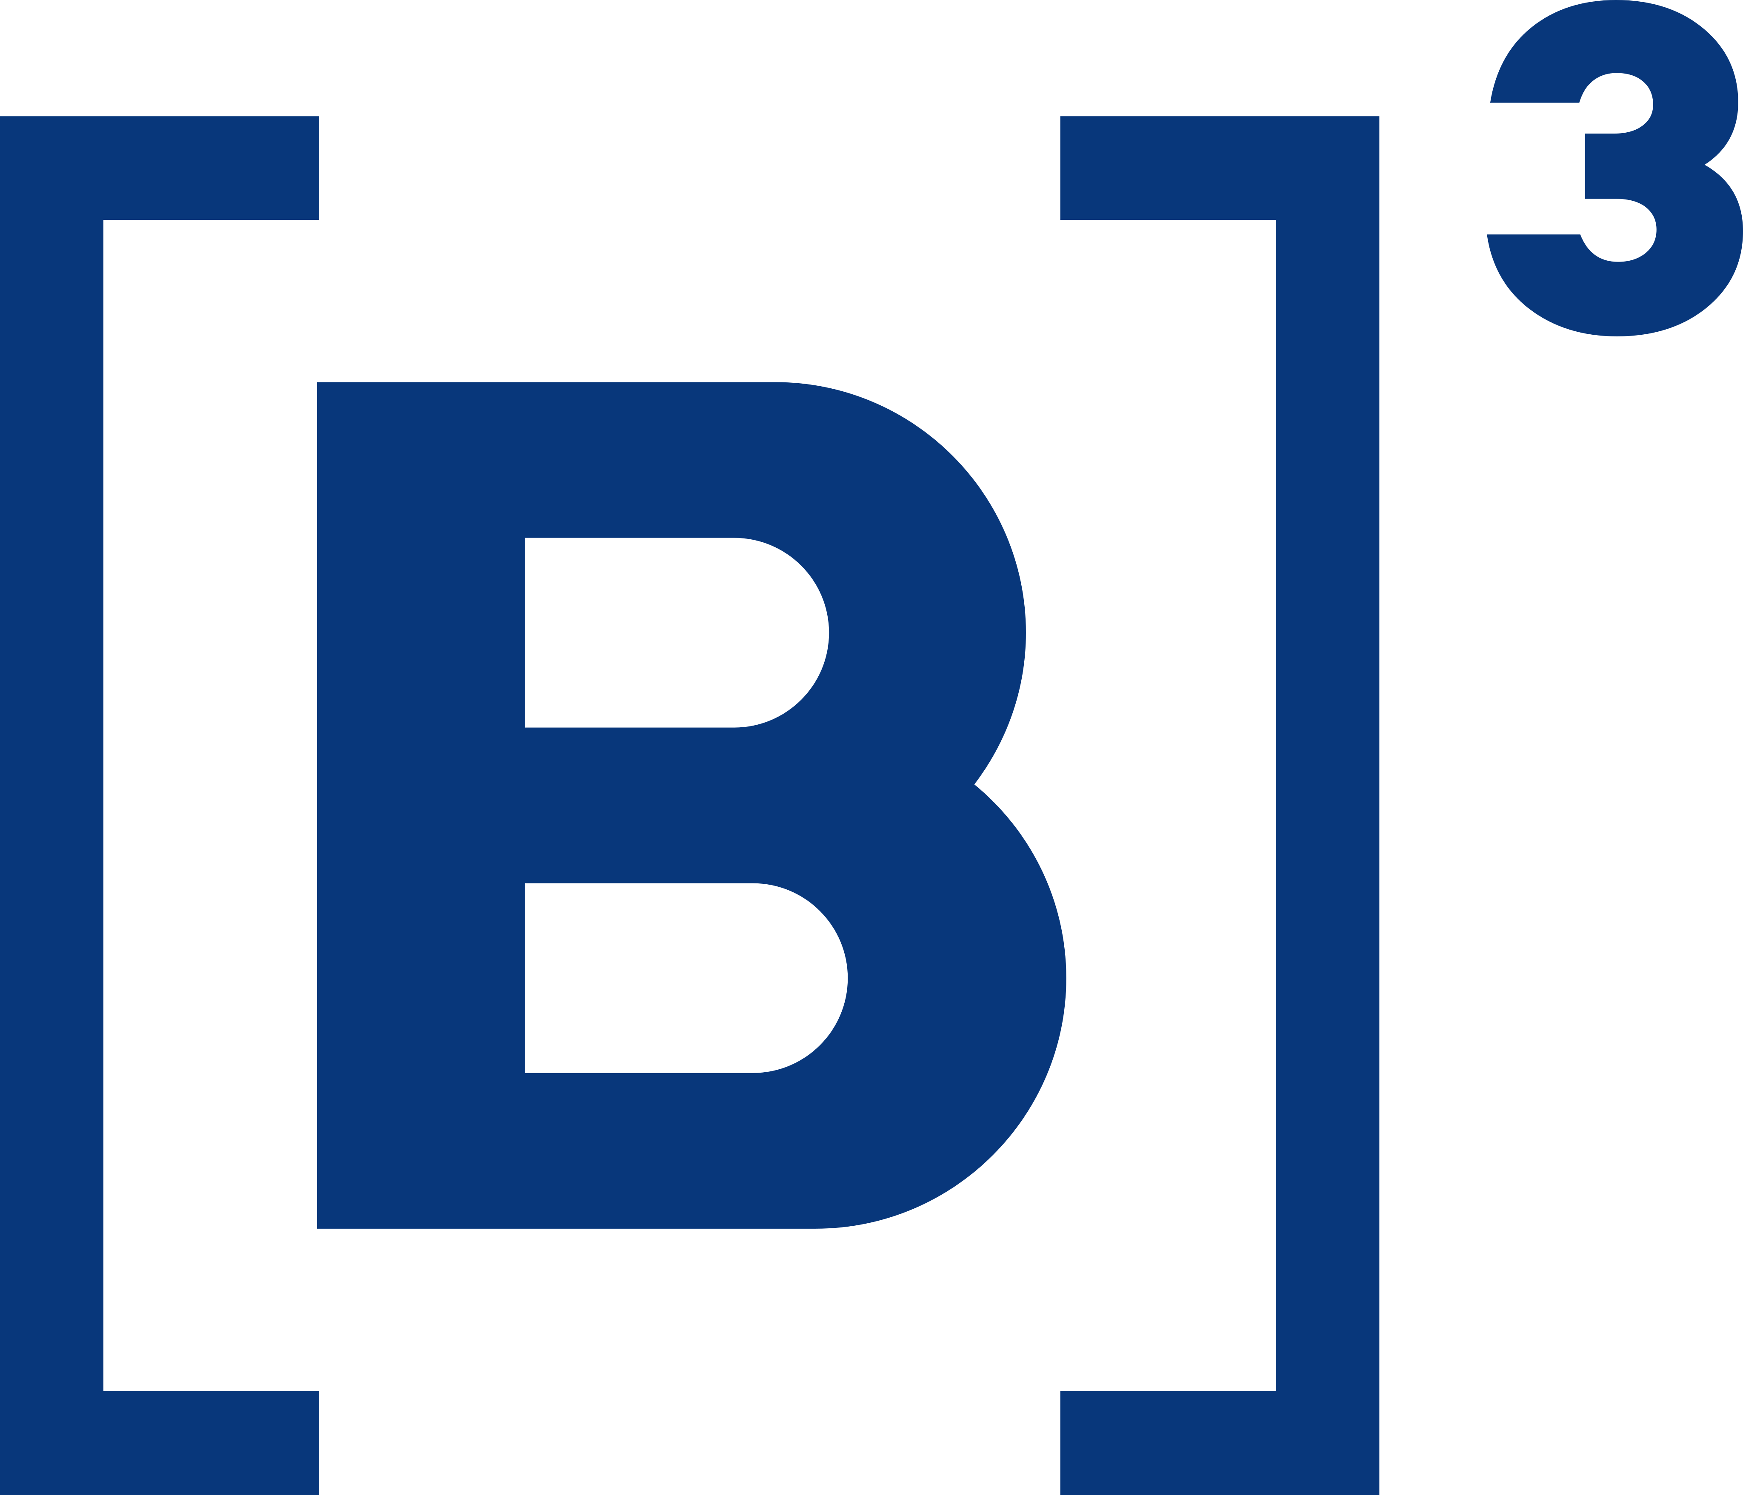
Collateral Management Services – Outsourcing Model
Outsourcing model : Local market infrastructure offers the Collateral Management Service to its market participants in its own name and outsources the technical processing and some operational activities to Clearstream.
Implemented in:
Australia (ASX)
Brazil (B3)
Germany (CBF)
South Africa (STRATE)
Spain (Iberclear)

Slide 5
Collateral Management Services – Joint Service Model
Joint Service model : Local market infrastructure and Clearstream jointly offer the Collateral Management Solution to market participants with Clearstream covering the Collateral Management Service.
Implemented in:
Canada (TMX)
Chosen as best fitting the need for customer base and requirement for internationalization (key domestic players also ICSD participants & access to international assets defined as key).

Slide 6
Benefits of Partnership
Leveraging Clearstream Collateral Management Services
Increase value-added service
Market can provide existing clients with new services and products
External expertise and knowledge
Leverage existing knowledge and experience from partners who have already become experts in the product/service
Outsourcing non-core activities
Allows resources to remain dedicated to core functions
Reduced resource requirements
Leverage external resources already in use by partner
Maintain relationship with underlying clients
Allows market participants to remain connected to key infrastructure within the partnership
Cost considerations
It may be more cost effective to partner with existing platform vs. building a new solution from scratch
Faster marketability
Time-to-market is faster through a partnership, which leverages existing vs. building new technology
Flexibility and scalability
Ability to create bespoke solutions to fit specific market needs and regulations

Slide 7
Thank you!
Gregory Rodeheaver
Director | Head of Client Relations Americas
Clearstream Banking SA 1155 Avenue of the Americas, 19th Floor NY, NY 10036
Phone +1.347.404.0702 E-mail gregory.rodeheaver@clearstream.com
Nathalia Teofilo
Vice President | Relationship Management - Americas
Clearstream Banking SA 1155 Avenue of the Americas, 19th Floor NY, NY 10036
Phone +1.347.952.6488 E-mail nathalia.teofilo@clearstream.com
7

