Slide 1
Digital-Financial Market Infrastructure ACSDA 2024

Slide 2
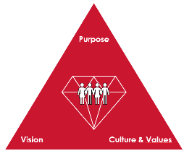
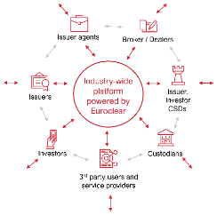
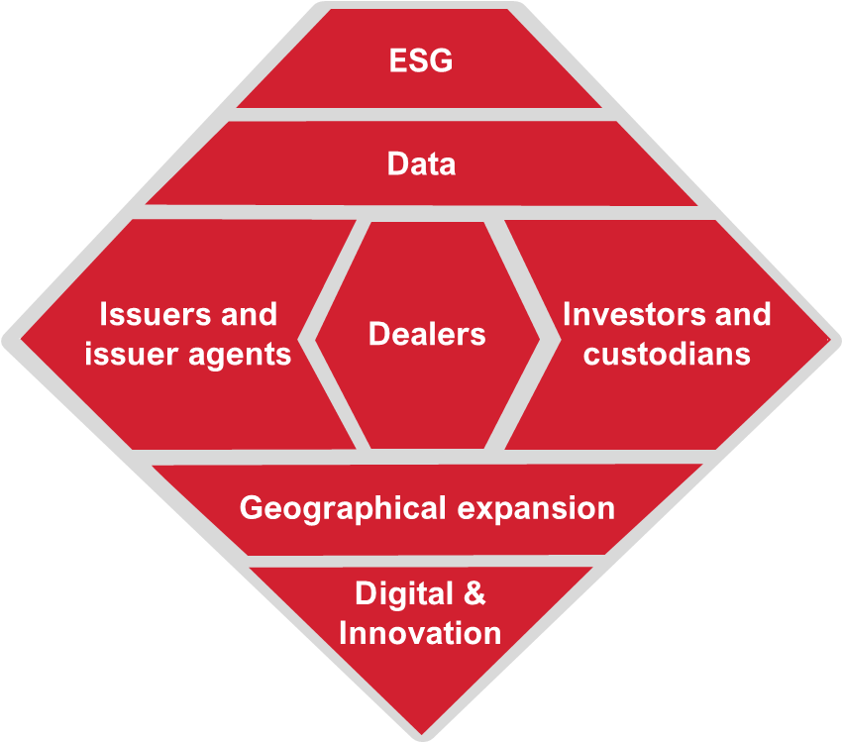
Our long-term vision is based on our renewed purpose
WHY
Our Group Purpose
We innovate to bring safety, efficiency and connections to financial markets for sustainable economic growth
Our Long Term Vision
WHAT
Our long-term vision is to become an open shared platform providing a catalogue of data-enabled services offered by us or 3rd parties and available to all market players. It is designed as an industry-wide open architecture across asset classes, complementing our existing settlement and custody processing with data enabled services, regardless of assets holding place and data source
HOW
Our Facet Strategy
We take a stronger client lens, co-creating, launching, and scaling strategic initiatives for issuers & agents, investors & custodians and dealers. By developing Data, ESG and Digital solutions to deliver sustained growth across geographies and asset classes to further strengthen our self-reinforcing ecosystem of partners and clients

Slide 3
In order to achieve our long-term vision, we defined a 5-year Strategy with a stronger focus on the Client journey
ESG
2
Our Strategy will guide our strategic direction towards 2026 and beyond
Data
1
Take a stronger client lens reinforcing the virtuous circle of bringing all clients into one self-reinforcing ecosystem, focusing on launching and scaling strategic initiatives taking a holistic approach towards investors issuers and dealers needs
1
Issuers and issuer agents
Dealers
Investors and custodians
Geographical expansion
2
Develop ESG, Data, Geographical expansion and Digital solutions to address industry pain points, reduce costs and risks and deliver sustained growth across geographies and asset classes
2
Digital & Innovation
3
We defined 3 key enablers (i.e., People, Technology and M&A) to support the achievement of our strategy by driving the transformation pace and scale
3
People
Technology
M&A

Slide 4
Time to act is now!
We are currently at the intersection of market, regulatory and technology readiness to act
The Market is Transforming with rapid development of services across the value chain
Central banks and regulators are massively experimenting with CBDC and there are Pilot regimes emerging to increase even more the opportunities for DLT for traditional players and new entrants
Availability of market lessons. Getting the second mover advantage
What will Euroclear do and how will we do it.

Slide 5
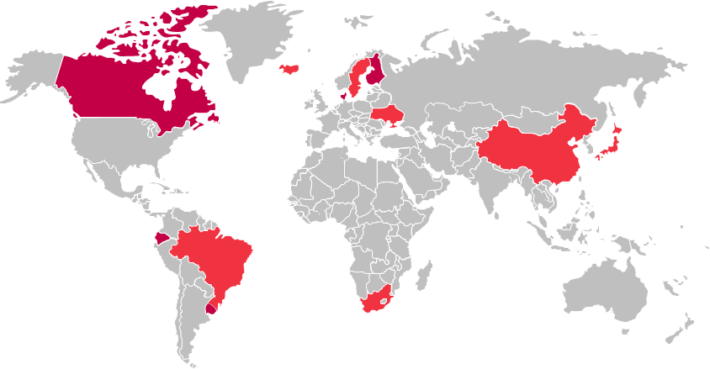
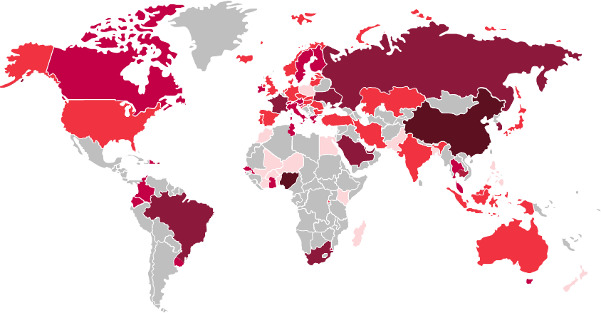
Central banks have increased CBDC initiatives.
Central banks are actively experimenting or implementing DLT (CBDC) solutions – arising from the desire to improve international payments as well as geo-political considerations around reserve currencies.
Jan 2018
Jan 2022
CBDC Initiatives (Jan 2018)
CBDC Initiatives (Jan 2022)
0
Interest
Countries declaring interest and initial research to explore CBDC feasibility
15
Interest
Countries declaring interest and initial research to explore CBDC feasibility
10
Research
Countries that published CBDC research reports and/or conducted early PoCs
25
Research
Countries that published CBDC research reports and/or conducted early PoCs
6
Experimentation
Countries experimenting and piloting CBDC with limited number of parties
15
Experimentation
Countries experimenting and piloting CBDC with limited number of parties
0
Implementation
Countries preparing their CBDC for a full-scale launch
6
Implementation
Countries preparing their CBDC for a full-scale launch
0
Launched
Countries that officially launched a CBDC
2
Launched
Countries that officially launched a CBDC
Sources: Bohem Tech, CBDC Tracker

Slide 6
Our DLT strategy is guided by key principles…
Market Optimization
DLT allows to reduce pain points and identify operational efficiencies to unlock trapped value and provide new value propositions for the market.
Ecosystem Value Driven
Redefine interrelationships, reposition market entities, and rework roles and responsibilities to ensure inclusivity for all market players.
Market Collaboration
Coordinate with key market players and regulators to co-create optimal workflows and ensure alignment across all parties.
Business Value Creation
Identify and prioritize the use cases that are most applicable and feasible to add tangible business value.
Strategy
Alignment
Ensure the north star evolves to support Euroclear’s and key stakeholders' overall business strategy
Euroclear Growth & Market Leadership
The deployment of smart DLT services will strengthen our market infrastructure position and allow us to drive discussion with key market players on the re-shaping of the industry.

Slide 7
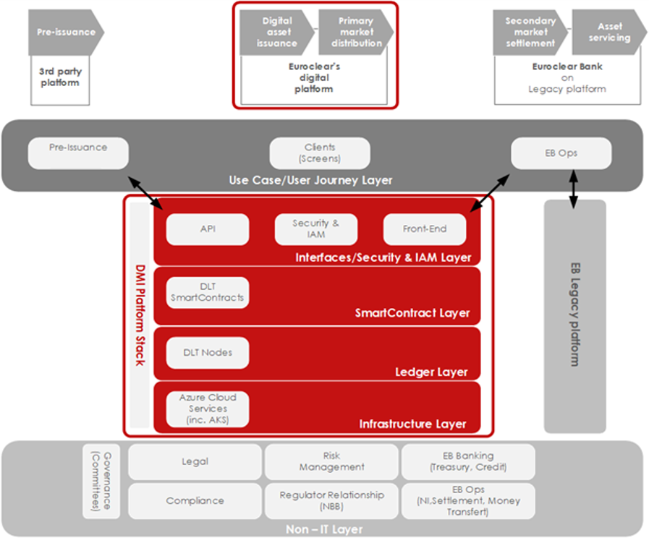
Cloud-based DLT foundations
A robust DLT platform, built on Corda R3 (V4) :
Private and permissioned ledger
Scalable network (tested with up to 20000 tps by R3)
Deterministic settlement finality (PoA consensus)
“ESG friendly” (PoA consensus, Data distribution vs replication)
Modular architecture
Built to interact with other DLT & blockchain networks
With the objective to support Financial Market Infrastructure services:
CSDR compliant
FMI-grade digital operational resilience
D-FMI is designed to be interoperable with legacy and other DLT networks
Notes:
Infra
Azure Cloud (corporate choice),
Resilience: 3 AZ in one Data Center with replication of data
Kubernetes deployment
Automated CI/CD
DLT Network
Nodes hosted by Euroclear, but get ready for decentralization when clients are ready
Private keys management in HSM replicated in two zones (direct and indirect access from user when node is requested to sign a transaction)
Each single Node needs to be certified in order to be authorized to join the DLT Network and to have peer-to-peer communication with the other nodes. The Private Key Infrastructure (PKI) to manage certificates assigned to Nodes is controlled by Euroclear SA/NV.
Smart Contracts
Corda with business logic coded in smart contracts (reference data, workflows)
Access & permissioning
- RBAC & user permissions enforced at API layer and controlled at Corda node level.
MFA for user interfaces access
User permissions are granted by Client’s administrator
User Interfaces for
Issuer Agent,
Dealer
Euroclear ops
Interoperability with legacy or pre-issuance platforms

